Slide 1
Traffic Sign Recognition Using Computer Vision
Scott Locke
2021/09/21
DSI Capstone Presentation

Slide 2
Problem Statement
Self-driving cars are the way of the future, from personal use, deliveries, shipping and more. Here at WAVE (Washington Automated Vehicle Enterprise) we are looking to break into the market for self-driving cars and want to test car capabilities in identifying different types of street signs, and the information contained on them.

Slide 3
Datasets
From the German Institut Für Neutoinformatik at Ruhr-Universität Bochum
German Traffic Sign Recognition Benchmark (GTSRB)
>52,000 images (~39,000 training, ~13000 test) of German traffic signs
42 classes of signs
Speed, hazard warnings, traffic control, etc
Training are from tracks of images
German Traffic Sign Detection Benchmark (GTSDB)
900 images (600 train, 300 test)
Can contain, none, one, or multiple signs
Provided is bounding boxes and class id

Slide 4
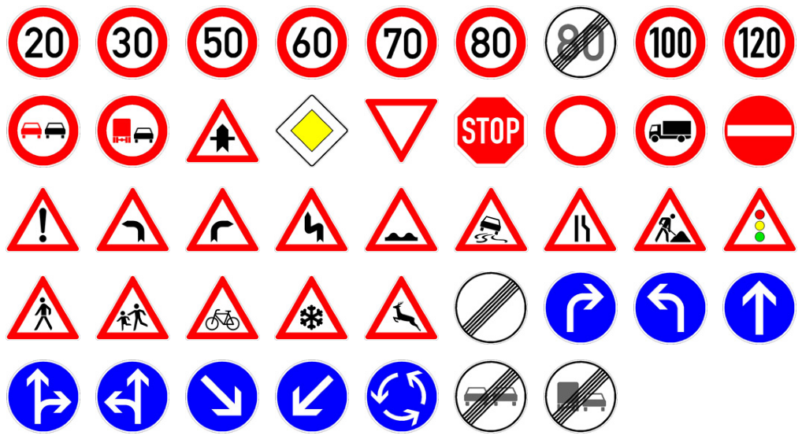
German Traffic Signs

Slide 5
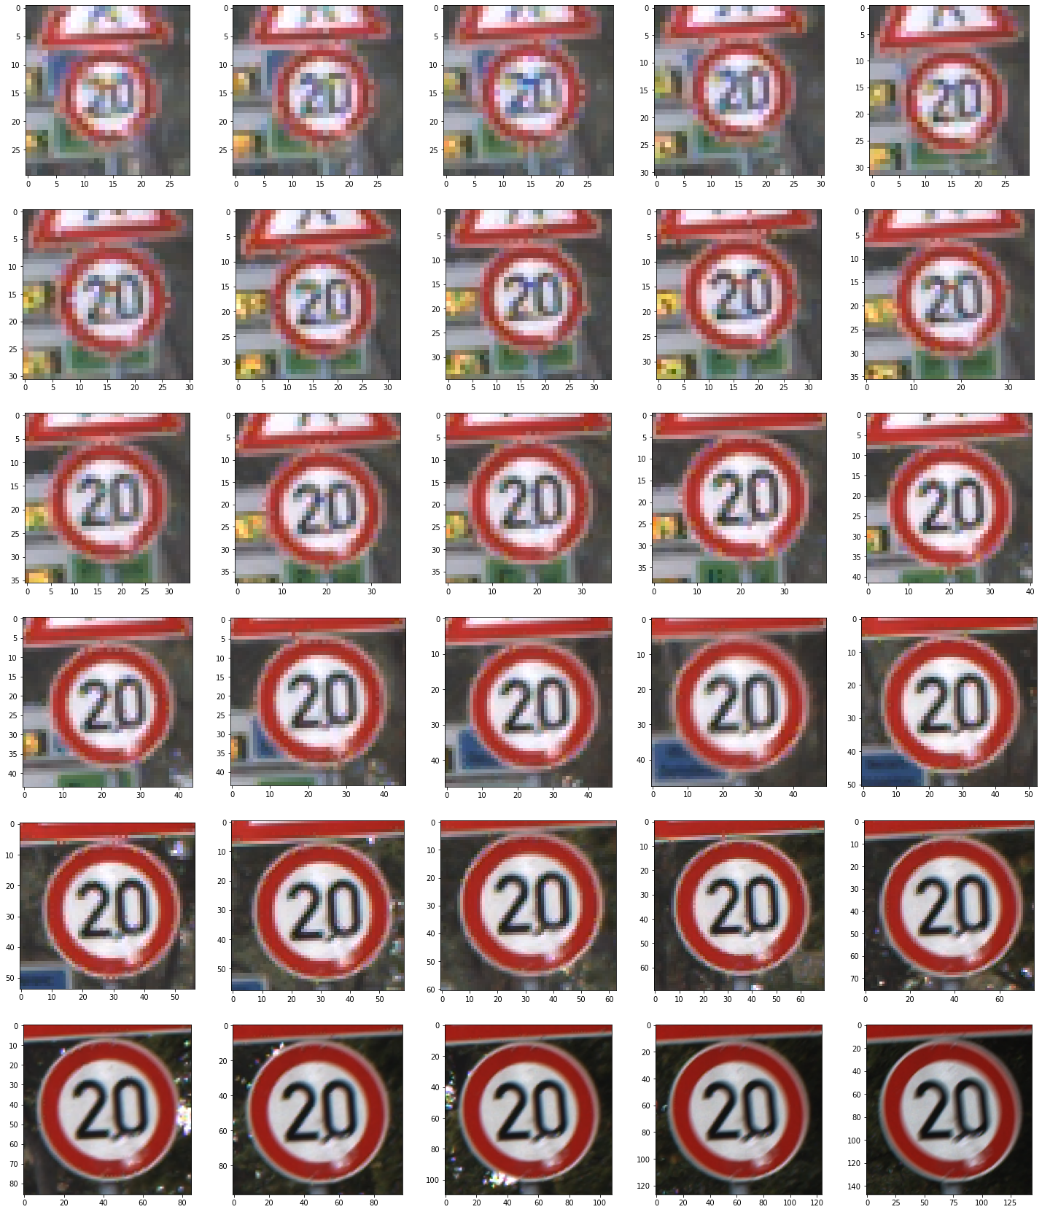
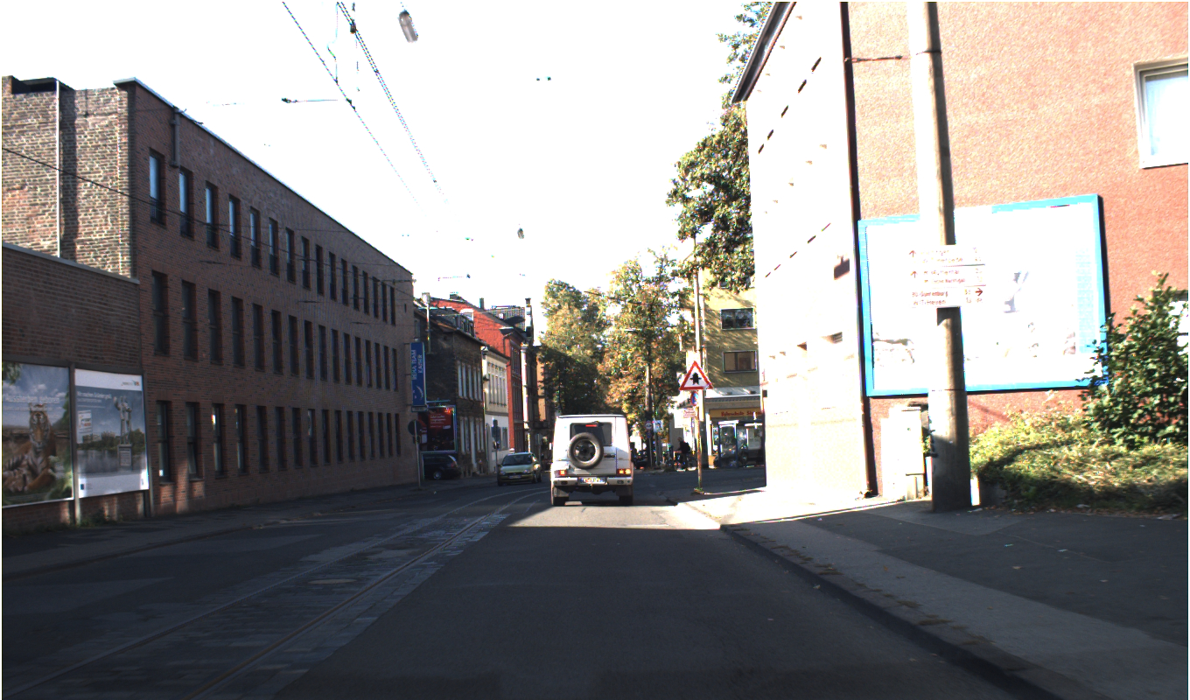
1 Full Track GTSRB
Single Image GTSDB

Slide 6
Workflow
Import and explore data
EDA
Image Preprocessing and Additions
Model GTSRB with CNN
Model GTSDB with Mask RCNN
Extract Bounding boxes from GTSDB results
Input into GTSRB model
Evaluate
Mask RCNN
Prep

Slide 7
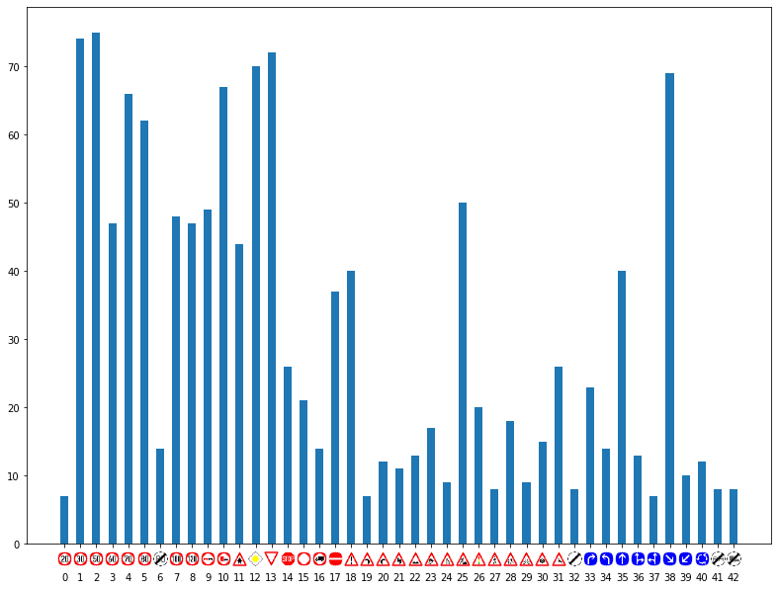
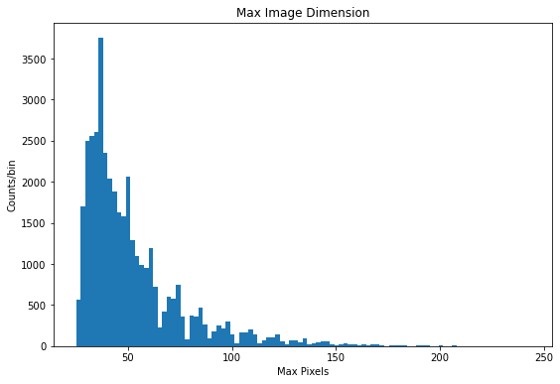
EDA
Class composition
Ranges from 210-2250 training images per category
Largest category <6% of training data
GTSRB:
10% border (at least 5 pixels) around sign
Most images <50 pixels in any dimension

Slide 8
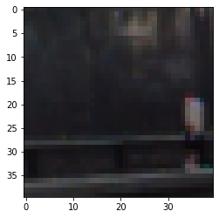
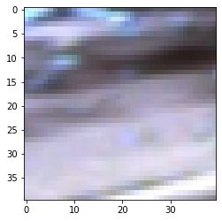
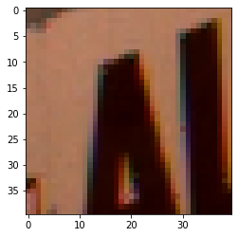
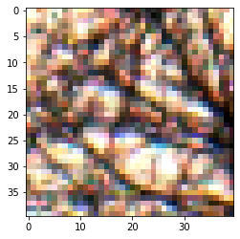
Image Processing and Additions
Standardize GTSRB image size for CNN
40x40
Made addition BG class
GTSRB has only signs
Use GTSDB to create BG images
Image base size taken sampling GTSRB image size
2250 to training, 750 to testing
Tested
Normalization (contrast/brightness)
Mask padding

Slide 9
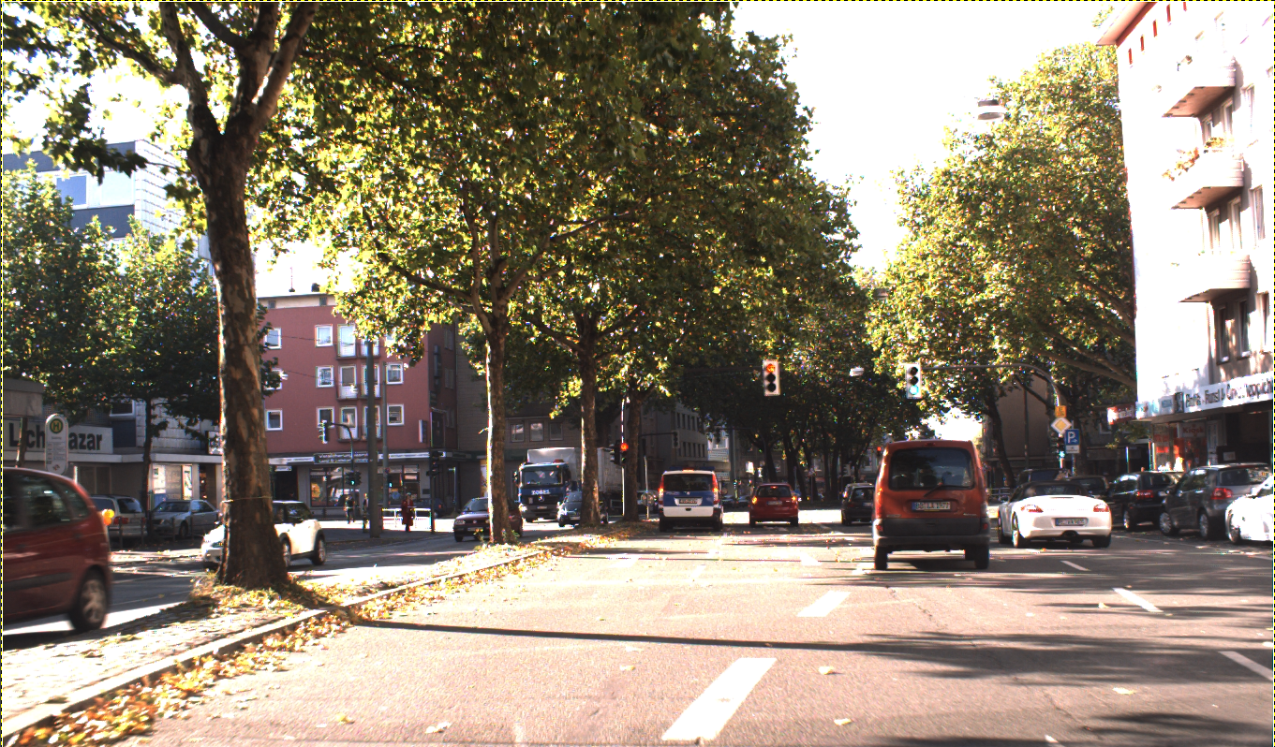
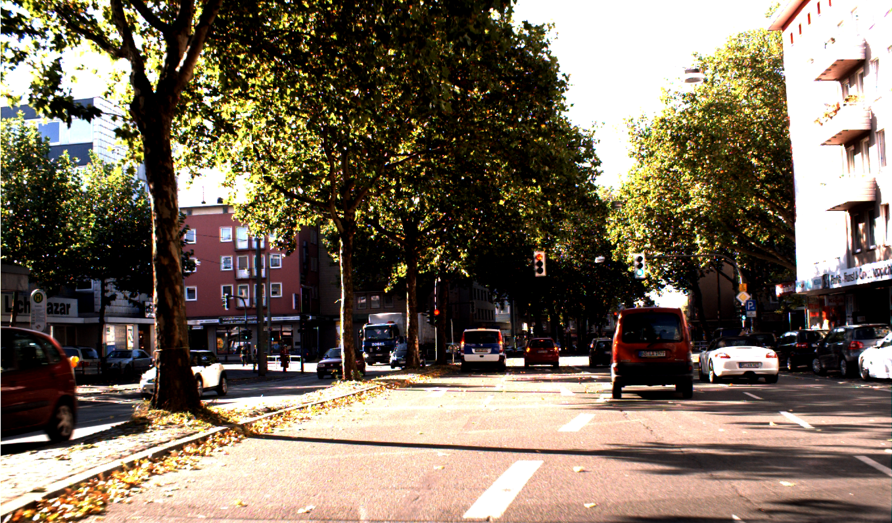
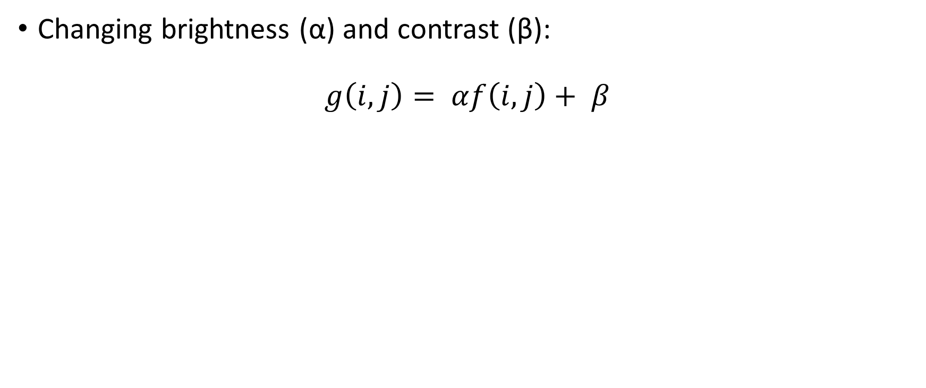
Image Normalization
Changing brightness (α) and contrast (β):
$$g\left(i,j\right)= αf\left(i,j\right)+ β$$

Slide 10
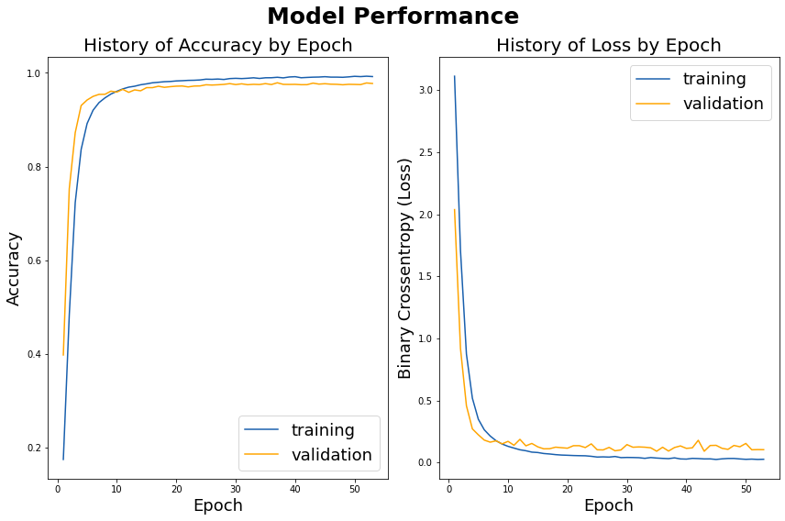
Modeling GTSRB
CNN
Vary:
CNN Layers
Dense Layers
Dropout
Final fit:
3 CNN layers, 256 (5,5) filters each
(2,2) max pooling after each
128 node dense layer
0.4 dropout after each pooling and dense layer
Depending on image configuration:
97-98% testing accuracy

Slide 11
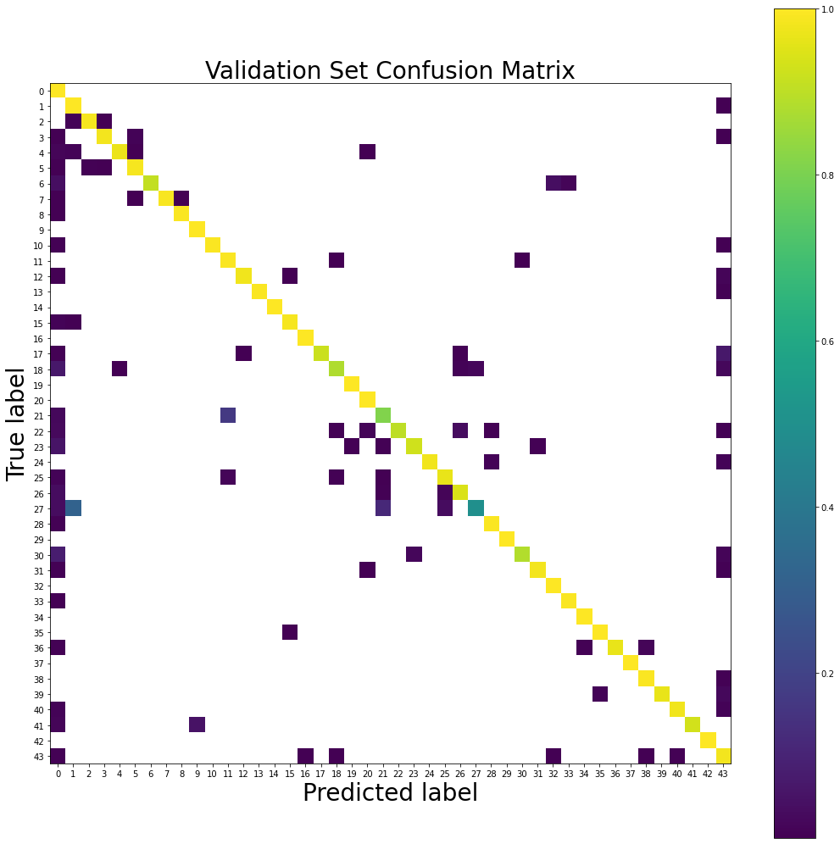
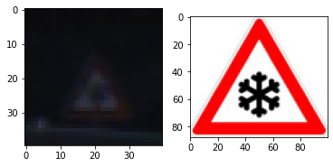
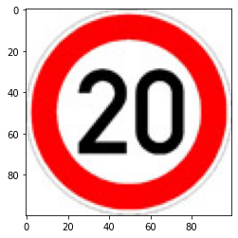
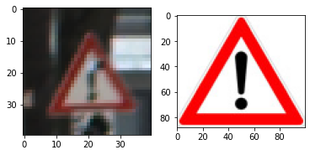
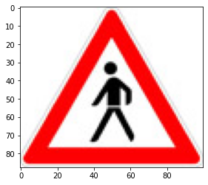
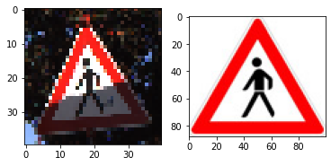
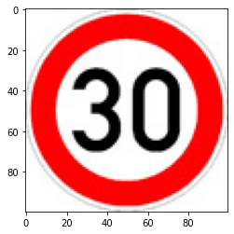
Image
Actual
Predicted
Weirdness
here

Slide 12
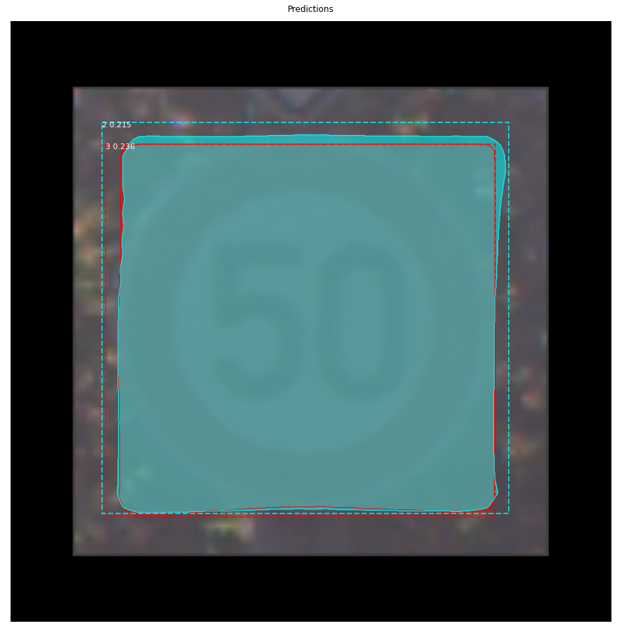
Mask RCNN Specific Prep
Predicts 40 and 50 at low confidence
(0.215 and 0.236 respectively)
Convert input bounding boxes and image shape
Unlike base CNN, made to take any image shape
Split Train/Test
GTSRB already done
GTSDB
Image 0-599 train
600-899 test
Did not perform well on sign only sample

Slide 13
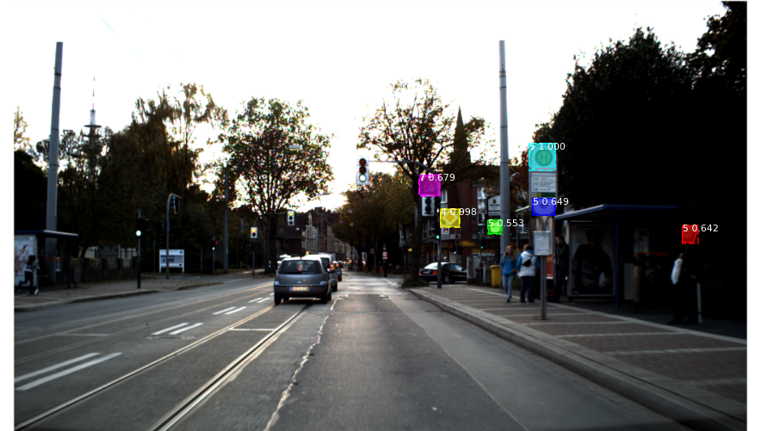
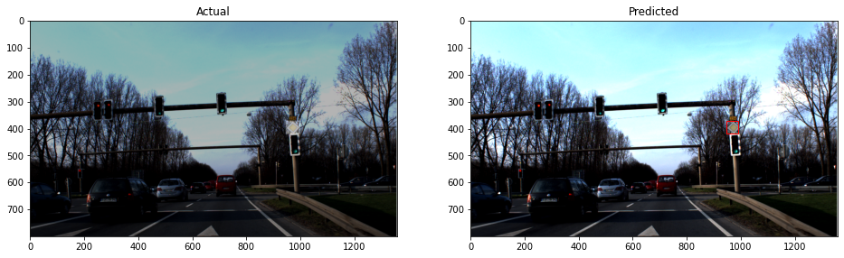
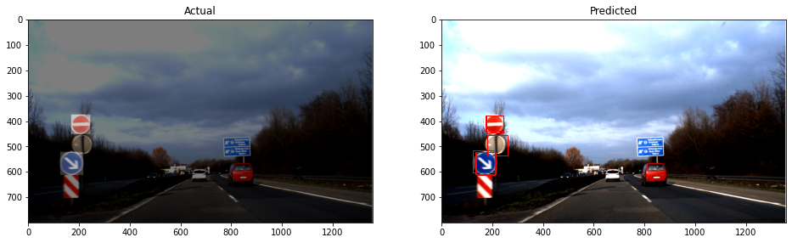
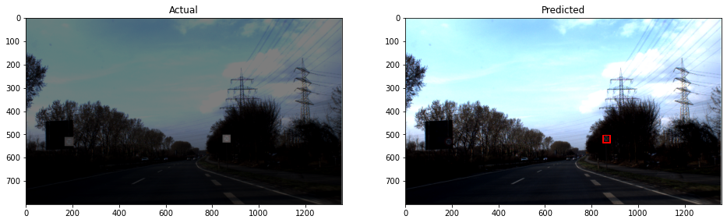
Mask RCNN on GSTDB
GSTDB are all 1360x800
Configuration:
Sign subcategories
Min Confidence:
Training: 0.5
Prediction: 0.1
Does well at identifying signs
86-93% effective at correctly masking signs
Struggles
Back of signs, stoplights, darkness
Did it right
Back of sign
Darkness

Slide 14







Sign Subcategories
Mask RCNN didn’t work well on GTSRB Make subcategories for general sign shape to reduce class types

Slide 15

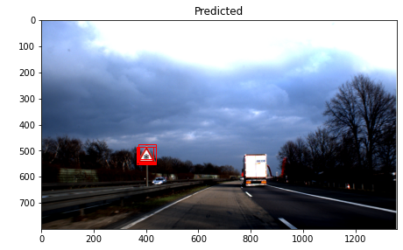
Extracting Bounding Boxes
Prediction min confidence at 0.1
Multiple Boxes in same area:
Cut at Intersection over Union of 0.6 (IoU)
If two boxes overlap, average the edges
Classification not very successful
Just save boxes, ignore class

Slide 16
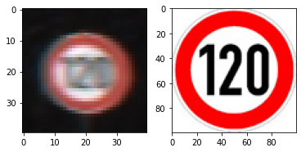
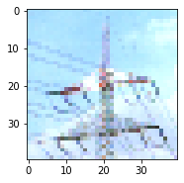
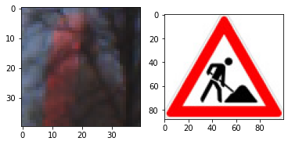
Return to GTSRB CNN
Image
Predicted
Correct Signal
We have
An effective net for just signs
Bounding boxes
Put them together
Extract subimages from GSTDB with bounding boxes
Add padding to better match
Feed into GTSRB CNN
Correct BG
Incorrect

Slide 17
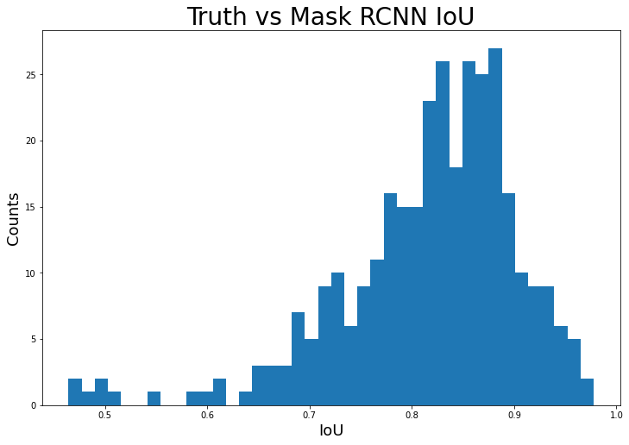
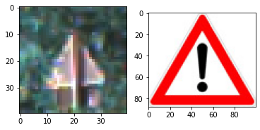
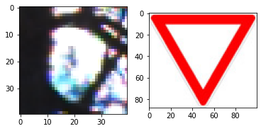
Results
Sign presence accuracy:
Use IoU > 0.4
86-93%
False sign identification:
0.46-0.86 extra boxes per image
0.25-0.50 extraneous “signs” per image (xs)
Sign accuracy:
97-99% accuracy where for correctly found signs
Best performance:
True sign recognition: 92.0%, .50 xs
Mask RCNN use original image
Reducing xs: 83.4%, 0.25 xs
Mask RCNN Brightness/Contrast correction
More targeted data would be useful

Slide 18
Conclusion
We successfully are able to identify location and type of sign types, showing promise for our fleet.
83-92% of signs are properly identified and classified
Extremely successful once a sign is found (up to 99%)
We have good indicators for how to better our performance
Added categories for troublesome types (back of signs, lights, other signs)
Better contrast images
Apply continuous nets

